Slide 1


ONLINE CLUSTERING: ALGORITHMS, EVALUATION, METRICS, CHALLENGES, APPLICATIONS AND BENCHMARKING WITH RIVER
Hoang-Anh Ngo, Télécom Paris, IP Paris, France
@LIAAD, INESC TEC, Porto, September 2022

Slide 2

OUTLINE
A (very brief) introduction to River
Online clustering algorithms:
Challenges and Solutions
Approaches
State-of-the-art algorithms
Further steps and Personal insights
Online clustering benchmarking with River
https://hoanganhngo610.github.io/river-clustering.kdd.2022/ https://doi.org/10.1145/3534678.3542600

Slide 3
REQUIREMENTS
Process one sample at a time, and inspect it only once
Use a limited amount of memory
Work in a limited amount of time
Always ready to predict
Notes:
The fact that River process one sample at a time will have certain impact on the design of clustering algorithms and metrics, will talk about that later.

Slide 4
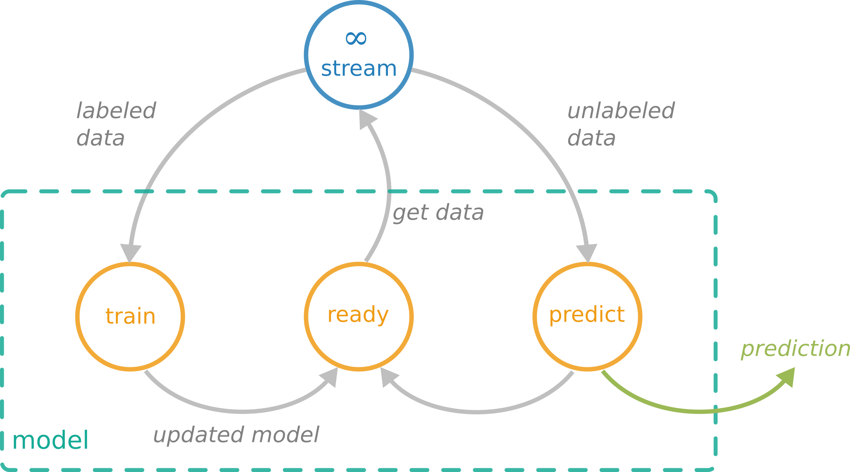
LEARNING FROM DATA STREAMS Supervised learning
One sample at a time
Limited resources
Predict at any time

Slide 5

DEFINITION OF CLUSTERING
Given a set of unlabeled instances, distribute them into homogeneous groups according to some common relations or affinities
Photo source: W. Kandinsky - Several Circles (edited)
EXAMPLES
Market segmentation
Social network communities

Slide 6
AVAILABLE SOFTWARES
Very few implementations (only most prominent ones) and unified frameworks with multiple algorithms co-existing:
Massive Online Analysis (MOA): Most popular framework, written by Bifet et al. (2010) in Java, including the most number (7) of clustering algorithms. However, one major disadvantage: only works well when information of data streams are previously known.
stream package: Written in R by Hahsler et al. (2018), with newer algorithms including D-Stream, DBSTREAM and evoStream.

Slide 7
AVAILABLE SOFTWARES
Very few implementations (only most prominent ones) and unified frameworks with multiple algorithms co-existing:
Subspace MOA framework: An extension of MOA from Java into R, written by Hassani et al. (2016), with extra algorithms including HDDStream and PreDeConStream.
streamDM: Written by Huawei Noah’s Ark Lab (2015) with Spark Streaming, an extension of Spark engine. Including CluStream and StreamKM++, but no plans for any further implementation

Slide 8
SOLUTION – RIVER
→ River comes into play, with a neat implementation that allows:
Works with any arbitrary numerical data stream;
Well-maintained, documented and includes various algorithms of different types.
Currently, River offers 6 clustering algorithms, including incremental K-Means, CluStream, DenStream, DBSTREAM, StreamKMeans (O'Callaghan et al., 2002) and evoStream (under a fully functional Pull Request) with a clear plan of further implementations.
Includes the most number of clustering algorithms apart from MOA.

Slide 9
STRATEGY
Basically, finding clustering solutions is an optimization task, with the following principle strategies:
Minimizing intra-cluster distances or radii of clusters (ensuring that objects within the same cluster are similar);
Maximizing inter-cluster distances or heterogeneity (ensuring that objects within different clusters are well-separated);
Maximizing likelihood estimates.

Slide 10
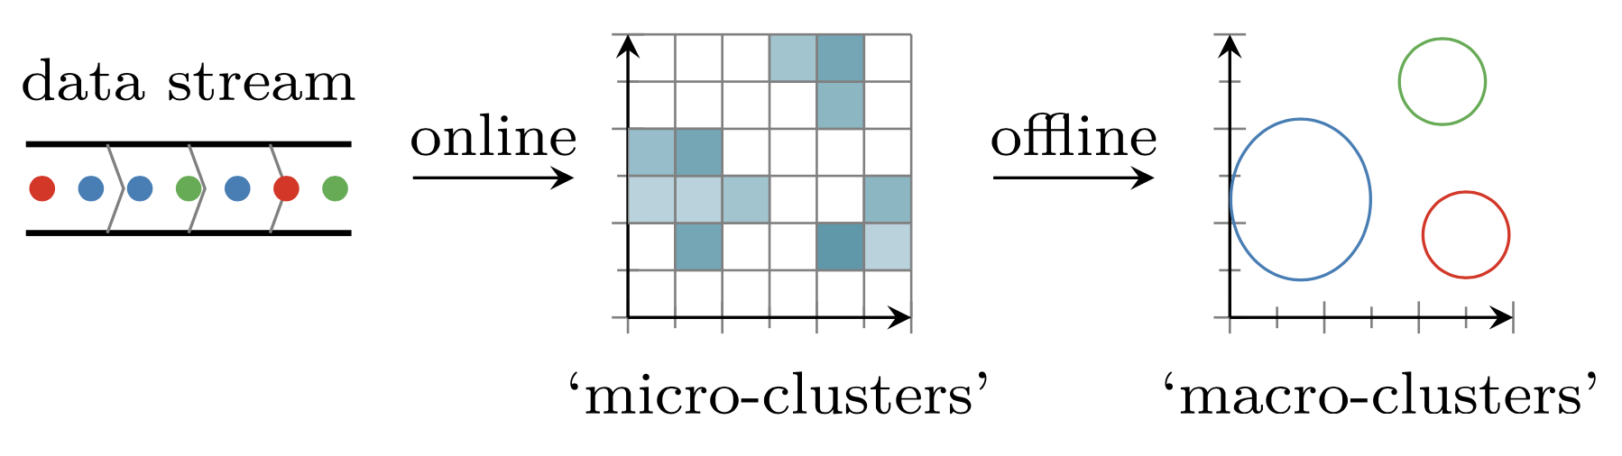
ARISING PROBLEMS
In online clustering, historical data will be discarded and only information of formed clusters (cluster centres, number of points, linear sum, sum of squares, etc.) will be saved → Clustering algorithms are divided into two phases: ONLINE phase and OFFLINE phase.
Two-phase stream clustering with grid-based approach
(Source: Matthias Carnein et al. 2017. An empirical comparison of stream clustering algorithms.)

Slide 11
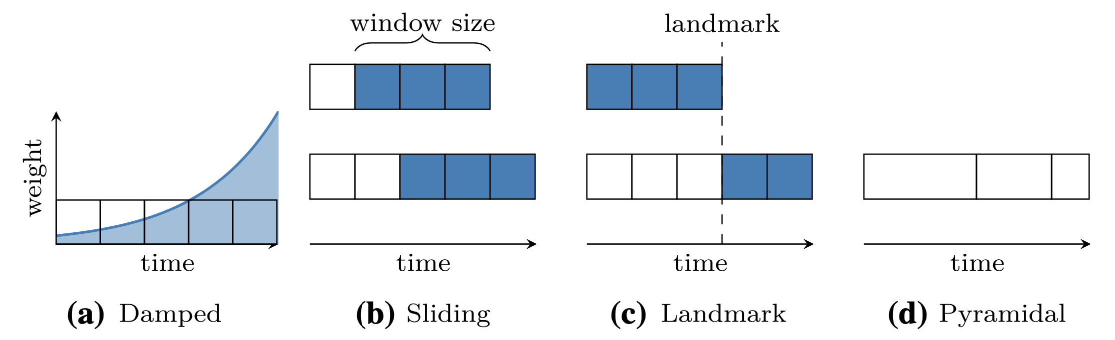
ARISING PROBLEMS
Through time, the distribution of the stream will change. (also known as drift or concept drift) → Models can employ time-window models, which only keeps the most few recent data points to avoid bias. This approach can include damped, sliding, landmark or pyramidal models.
Two-phase stream clustering with grid-based approach
(Source: Zhu Y. and Shasha D. 2002. Statstream: statistical monitoring of thousands of data streams in real life
and Silva J. A. et al. 2013. Data stream clustering: a survey.)

Slide 12
APPROACHES
Matthias Carnein and Heike Trautmann. 2019. Optimizing Data Stream Representation: An Extensive Survey on Stream Clustering Algorithms. Business and Information Systems Engineering 61, 3 (2019), 277-297. https://doi.org/10.1007/s12599-019-00576-5
Distance-based approach: threshold the distance of the new observation to existing clusters, either to insert or initialize new clusters, including:
Clustering Features (CFs), Extended CFs, Time-Fading CFs: BIRCH, CluStream, SDStream, ClusTree;
Centroids, Medoids: StreamKM++ (coreset), STREAM, RepStream (graph of nearest neighbors);
Competitive Learning: DBSTREAM.
Density-based (Grid-based) approach: capture the density of observation in a grid, by separating the data space among all dimension, including:
One-time or recursive partitioning: DUCStream, D-Stream, Stats-Grid;
Hybrid Grid-Approach: HDCStream, Mudi-Stream;
Notes:
Grid-based: Challenges: how to construct the cells, i.e how often and how to choose size of ceels

Slide 13
APPROACHES
Matthias Carnein and Heike Trautmann. 2019. Optimizing Data Stream Representation: An Extensive Survey on Stream Clustering Algorithms. Business and Information Systems Engineering 61, 3 (2019), 277-297. https://doi.org/10.1007/s12599-019-00576-5
Model-based approach: Summarize the data stream as a statistical model, with a common area of research based on the Expectation Maximization (EM) algorithm. Others include the use of an incrementally-built classification tree or concepts from linear regression. Including CluDisStream, SWEM, COBWEB, Wstream, etc.
Projected approach: This special approach deals with high dimensional data stream, addressing the curse of dimensionality. Including HPStream, HDDStream, and PreDeConStream along with their extensions.

Slide 14
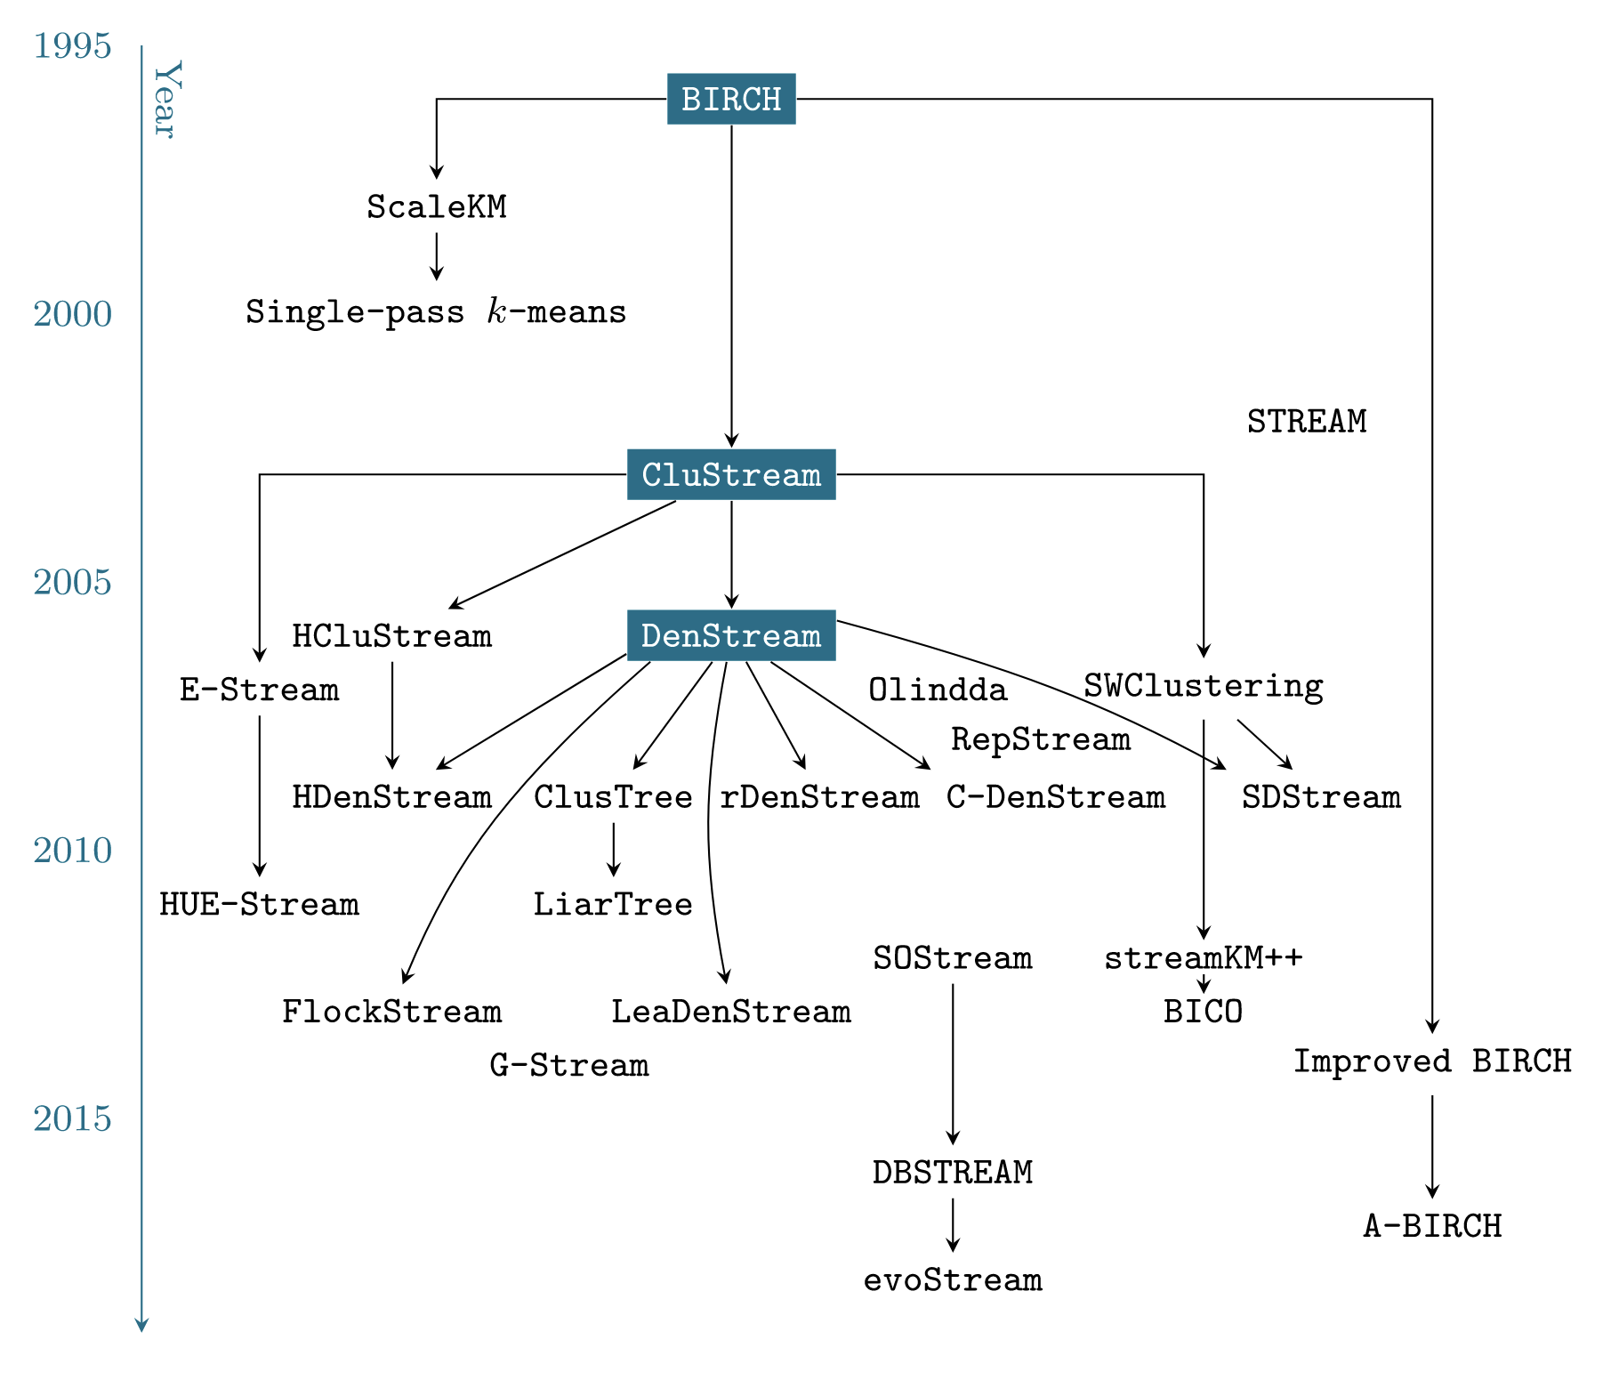
EVOLUTION OF ONLINE CLUSTERING ALGORITHS
Matthias Carnein and Heike Trautmann. 2019. Optimizing Data Stream Representation: An Extensive Survey on Stream Clustering Algorithm. Business & Information Systems Engineering, 61 (2019), 277-297. https://doi.org/10.1007/s12599-019-00576-5.

Slide 15
SIMPLEST IMPLEMENTED ALGORITHM: INCREMENTAL K-MEANS
Basically the simplest, naive approach that we can think of.
Most noticable parameter: halflife, which decides how much to move the cluster to the new point
Obtains comparable performance compared to more complicated algorithms, while maintaining a constantly low memory usage.

Slide 16
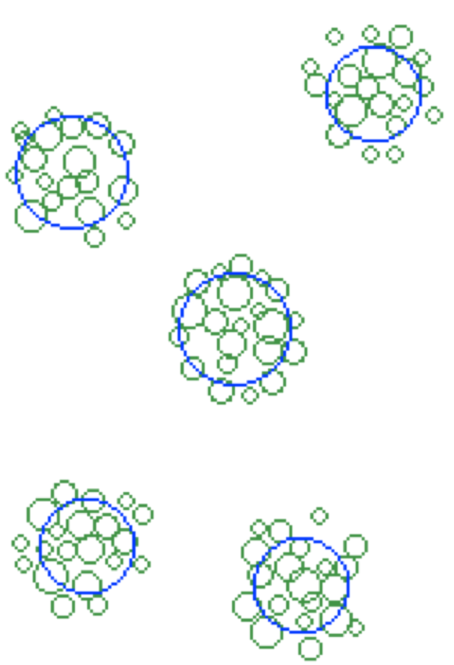
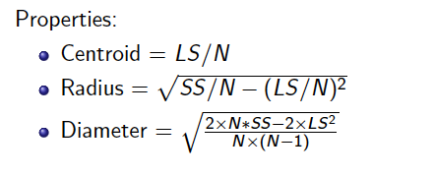
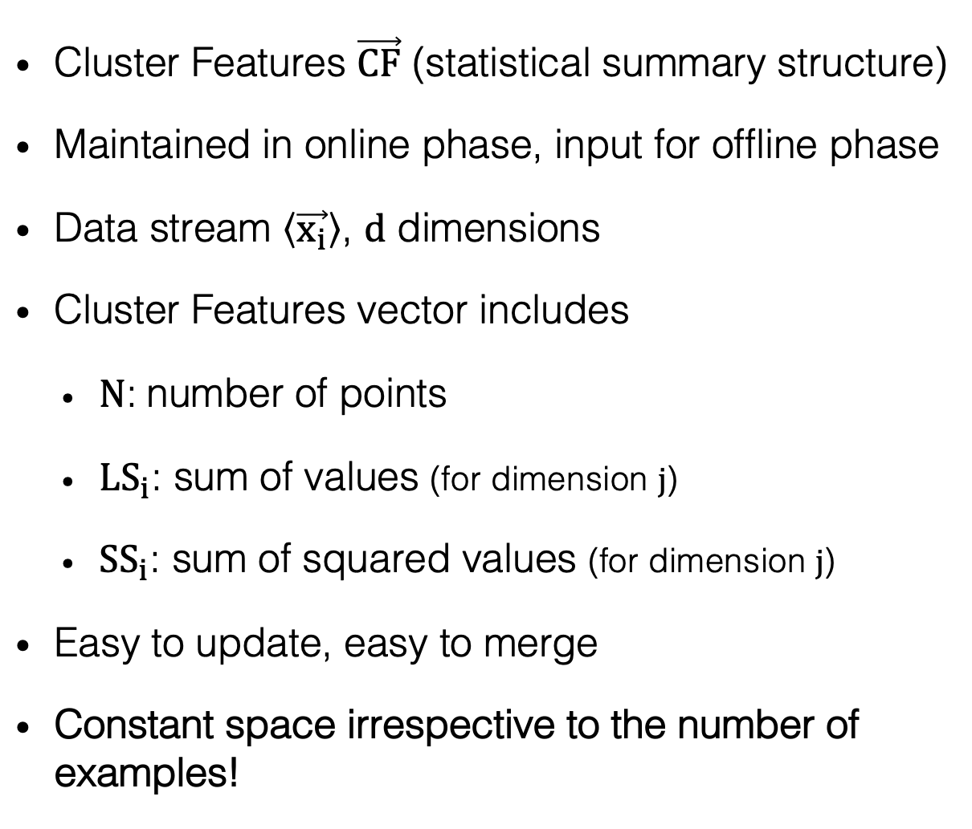
MICRO-CLUSTERS
Tian Zhang, Raghu Ramakrishnan, and Miron Livny. 1996. BIRCH: An Efficient Data Clustering Method for Very Large Databases. In SIGMOD’96: Proceedings of the 1996 ACM SIGMOD International Conference on Management of Data. Association for Computing Machinery, New York, NY, USA. https://doi.org/10.1145/233269.233324
Cluster Features $\vec{CF}$ (statistical summary structure)
Maintained in online phase, input for offline phase
Data stream $\left\langle \vec{x_{i}}\right\rangle$, $d$ dimensions
Cluster Features vector includes
$N$: number of points
${LS}_{i}$: sum of values (for dimension $j$)
${SS}_{i}$: sum of squared values (for dimension $j$)
Easy to update, easy to merge
Constant space irrespective to the number of examples!
Notes:
Assignment of point to micro-clusters: if points within boundary (or closest)

Slide 17
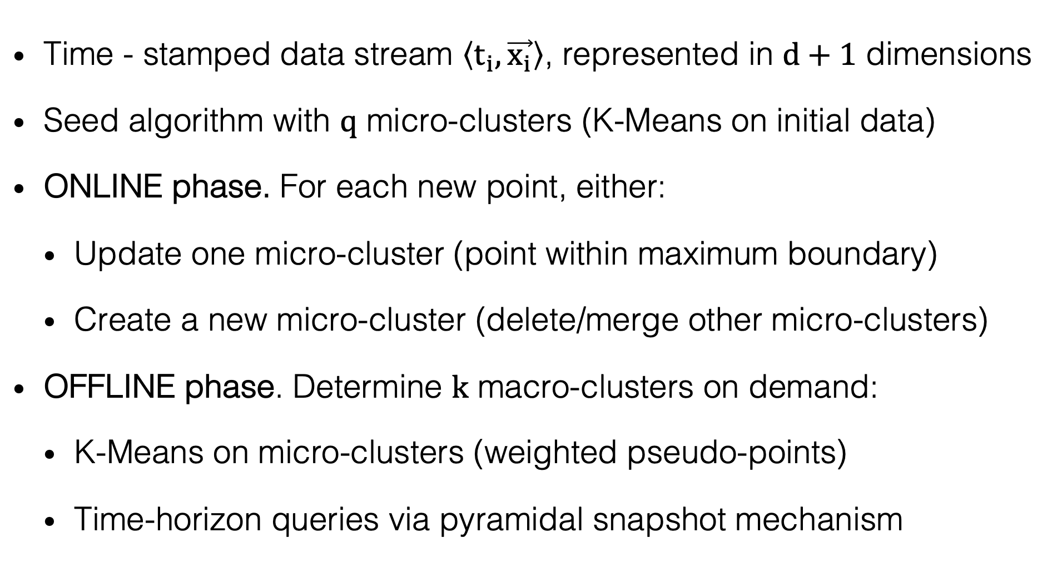
CLUSTREAM
Charu C. Aggarwal, Jiawei Han, Jianyong Wang, and Phillip S. Yu. 2003. A Framework for Clustering Evolving Data Streams. In: Proceedings of the 29th International Conference on Very Large Data Bases - Volume 29 (Berlin, Germany) (VLDB ’03). VLDB Endowment, Berlin, Germany, 81–92.
Time - stamped data stream $\left\langle t_{i},\vec{x_{i}}\right\rangle$, represented in $d+1$ dimensions
Seed algorithm with $q$ micro-clusters (K-Means on initial data)
ONLINE phase. For each new point, either:
Update one micro-cluster (point within maximum boundary)
Create a new micro-cluster (delete/merge other micro-clusters)
OFFLINE phase. Determine $k$ macro-clusters on demand:
K-Means on micro-clusters (weighted pseudo-points)
Time-horizon queries via pyramidal snapshot mechanism
Notes:
Seeds for offline k-means chosen proportionally to number of points in microcluster
Points are the centroid of the microclusters weighted by their number of points
Time-horizon queries by using a pyramidal snapshot mechanism

Slide 18
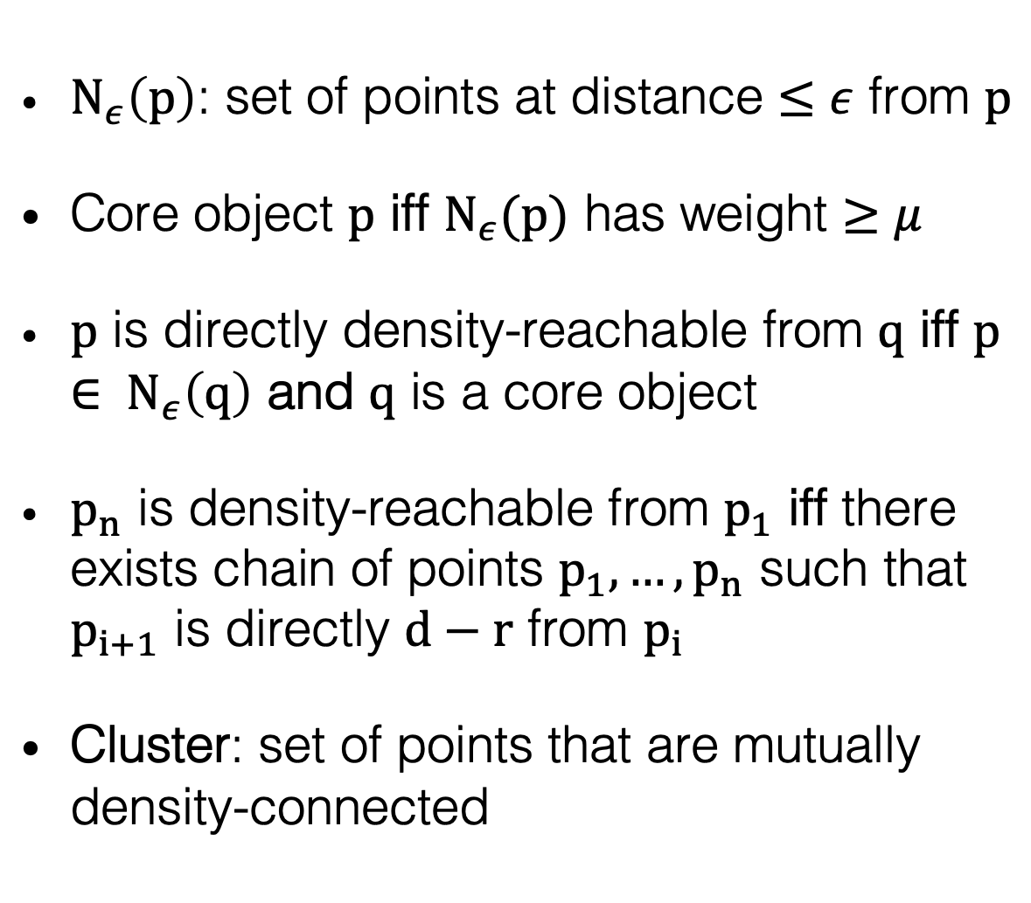
DBSCAN
Martin Ester and Hans-Peter Kriegel and Jörg Sander and Xiaowei Xu. 1996. A Density-Based Algorithm for Discovering Clusters in Large Spatial Databases with Noise. In KDD’96: Proceedings of the Second International Conference on Knowledge Discorvery and Data Mining. AAAI Press, 226-231. https://doi.org/10.5555/3001460.3001507
$N_{ε}\left(p\right)$: set of points at distance $≤ε$ from $p$
Core object $p$ iff $N_{ε}(p)$ has weight $≥μ$
$p$ is directly density-reachable from $q$ iff $p∈ N_{ε}\left(q\right)$ and $q$ is a core object
$p_{n}$ is density-reachable from $p_{1}$ iff there exists chain of points $p_{1},…,p_{n}$ such that $p_{i+1}$ is directly $d−r$ from $p_{i}$
Cluster: set of points that are mutually density-connected
Notes:
Non-spherical clusters
Weight µ depends on fading function

Slide 19
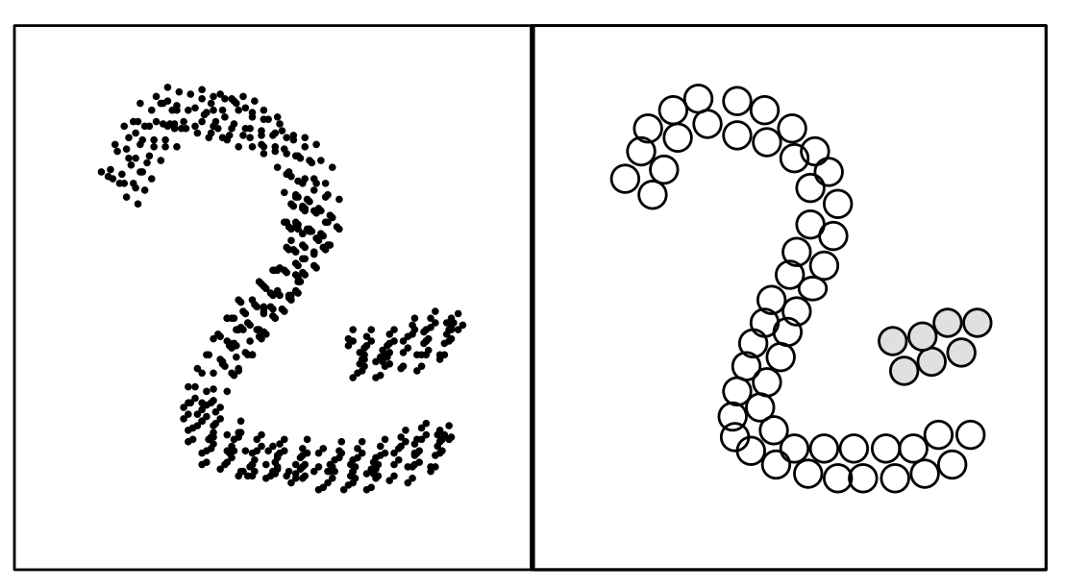
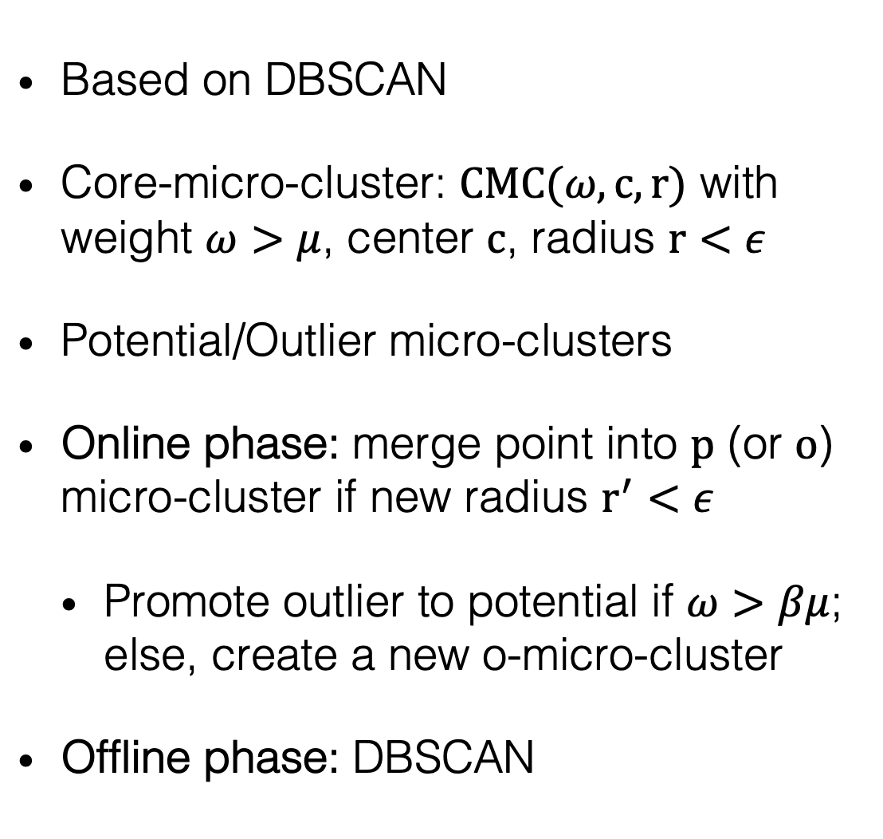
DENSTREAM
Feng Cao and Martin Ester and Weining Qian and Aoying Zhou. Density-Based Clustering over an Evolving Data Stream with Noise. In: Proceedings of the 2006 SIAM International Conference on Data Mining (SDM). Society for Industrial and Applied Mathematics (SIAM), 328-339. https://doi.org/10.1137/1.9781611972764.29
Based on DBSCAN
Core-micro-cluster: $CMC(ω,c,r)$ with weight $ω>μ$, center $c$, radius $r<ε$
Potential/Outlier micro-clusters
Online phase: merge point into $p$ (or $o$) micro-cluster if new radius $r^{′}<ε$
Promote outlier to potential if $ω>βμ$; else, create a new o-micro-cluster
Offline phase: DBSCAN
Notes:
Prune potential to outliers periodically

Slide 20
EVOSTREAM
Matthias Carnein and Heike Trautmann. 2018. evoStream – Evolutionary Stream Clustering Utilizing Idle Time. Big Data Research 14 (2018), 101-111. https://doi.org/10.1016/j.bdr.2018.05.005
A fairly new online clustering algorithm.
evoStream employs an evolutionary algorithm, first introduced by Maulik U. and Bandyopadhyay S. (2000), to utilize “idle” time efficiently to find better macro-cluster solutions.
In the evolution algorithm, promising solutions are combined to create off-springs which can combine the best attributes of both parents.
Include two phases: Micro-cluster maintenance (online learning phase) and evolutionary step of micro-cluster generation (offline phase)

Slide 21
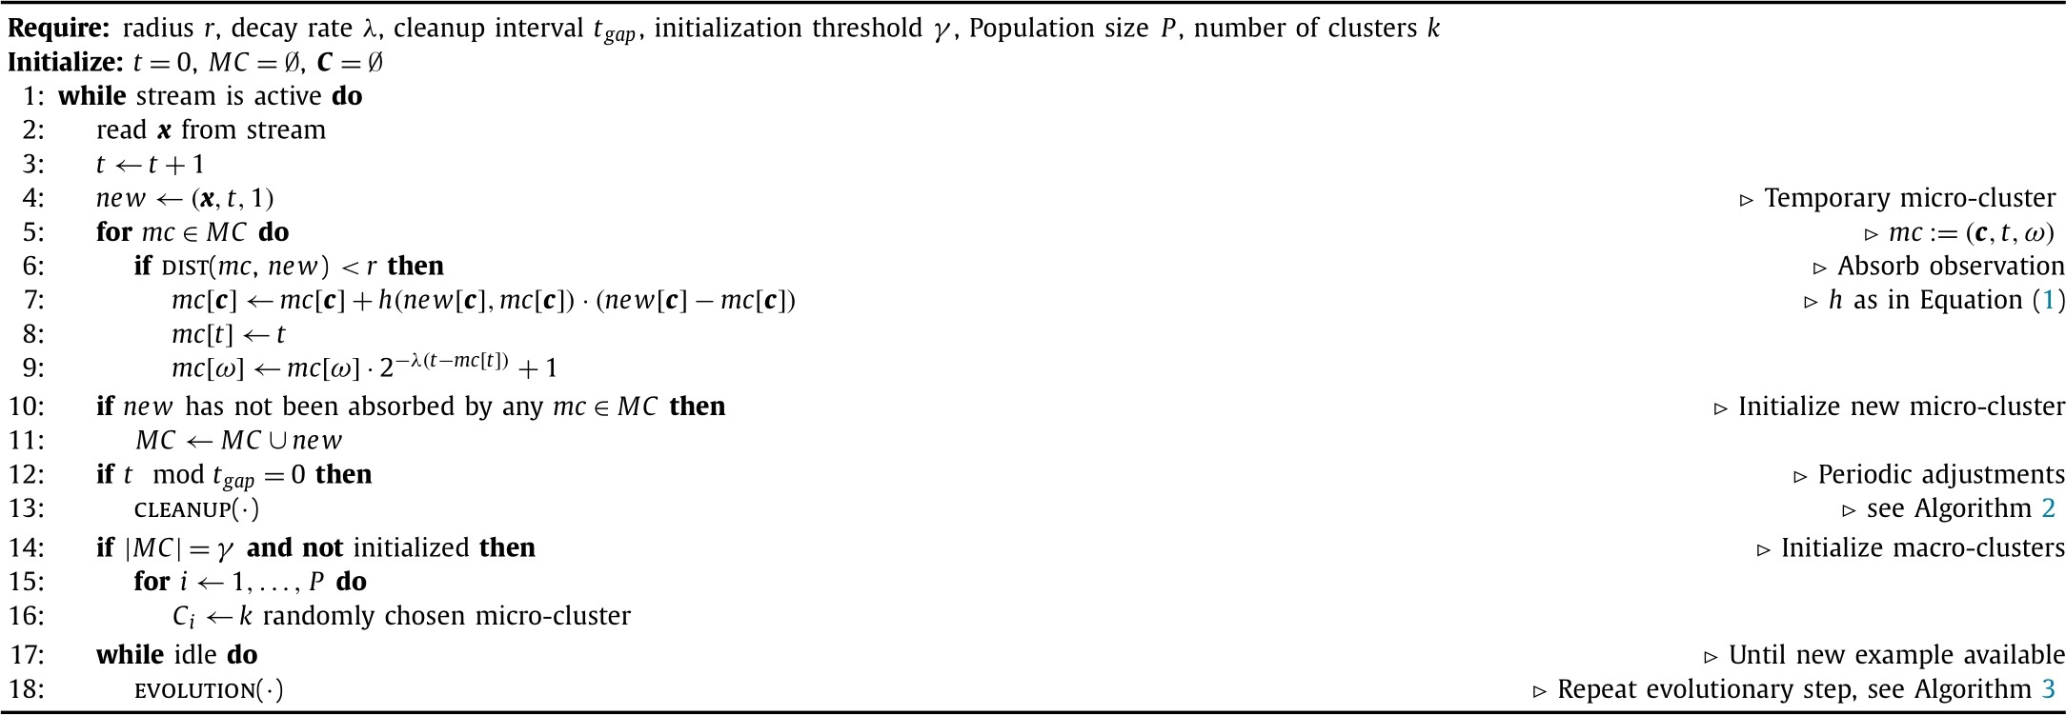
EVOSTREAM
Matthias Carnein and Heike Trautmann. 2018. evoStream – Evolutionary Stream Clustering Utilizing Idle Time. Big Data Research 14 (2018), 101-111. https://doi.org/10.1016/j.bdr.2018.05.005
evoStream algorithm (with both online and offline phase)
Notes:
Instead of simply updating the micro cluster based on the linear sum or “halflife” as Kmeans, EvoStream gets more “fancy” by using the Gaussian Neighborhood function

Slide 22
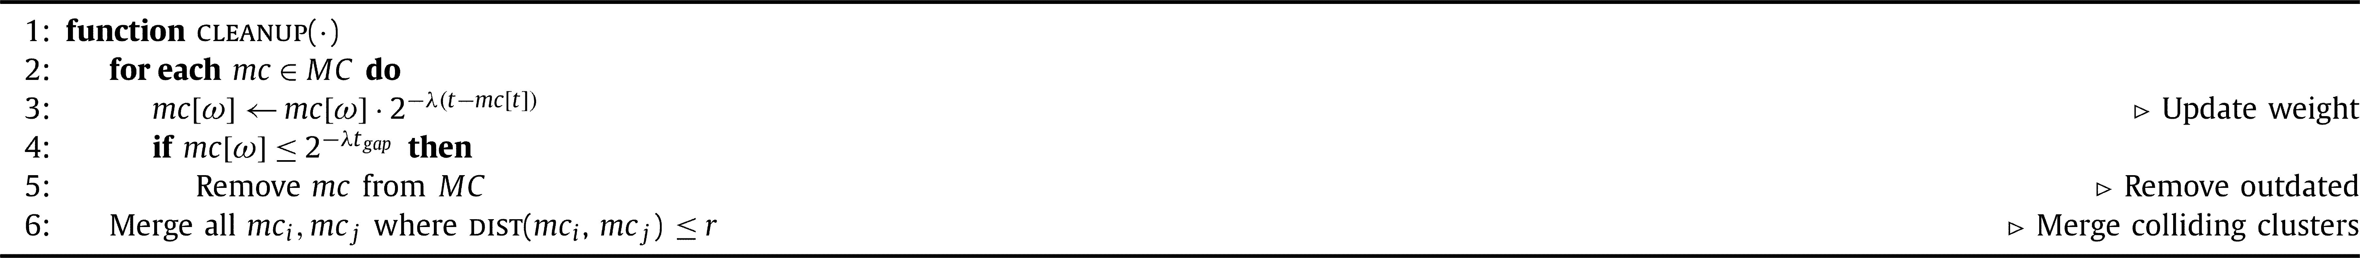
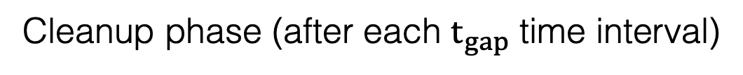
EVOSTREAM
Matthias Carnein and Heike Trautmann. 2018. evoStream – Evolutionary Stream Clustering Utilizing Idle Time. Big Data Research 14 (2018), 101-111. https://doi.org/10.1016/j.bdr.2018.05.005
Cleanup phase (after each $t_{gap}$ time interval)
Notes:
Discrepancy between what is described within the pseudocode and the detailed description within the river and the original Evolution Algorithm.

Slide 23
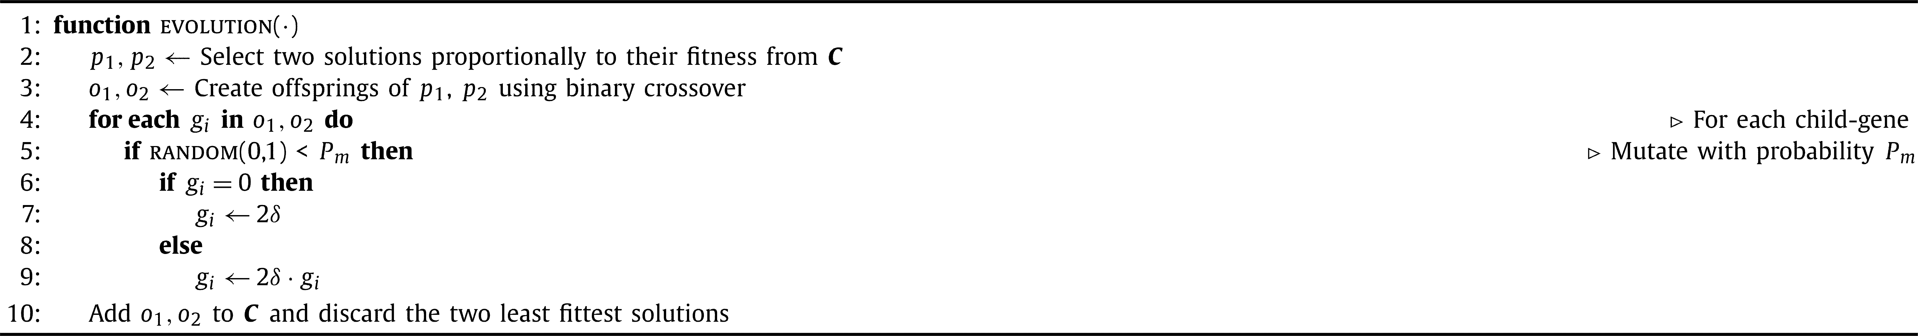
EVOSTREAM
Matthias Carnein and Heike Trautmann. 2018. evoStream – Evolutionary Stream Clustering Utilizing Idle Time. Big Data Research 14 (2018), 101-111. https://doi.org/10.1016/j.bdr.2018.05.005
Evolution algorithm (during idle time)
Notes:
This evolution algorithm is different from what is described in the paper, from the original version also → Refer to the paper of EA in 2000.

Slide 24
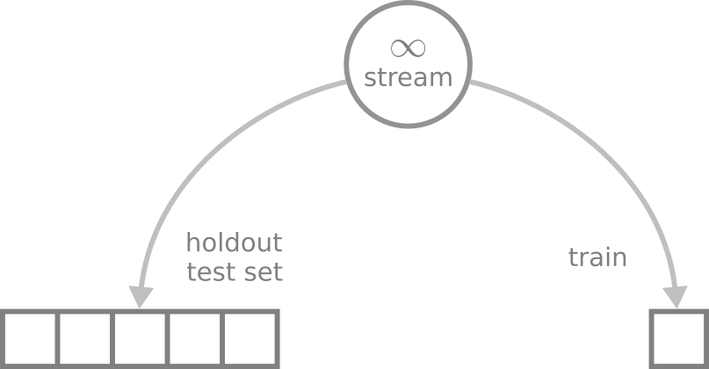

EVALUATION
Holdout an independent test set
Apply the current model to the test set, at regular time intervals
Unbiased performance estimation
Popular in batch and stream learning
Prequential
Test then train each new instance
Order matters!
All data is used for training
Performance is estimated on the sequence
Popular in the stream setting

Slide 25
CLASSICAL STATIC EVALUATION
4 basic internal (validation) metrics include
Cohesion: The average distance from a point in the dataset to its assigned cluster centroid. The smaller the better.
SSQ: The sum of squared distances from data points to their assigned centroids. Closely related to cohesion. The smaller the better.
Separation: Average distance from a point to the points assigned to other clusters. The larger the better.
Silhouette coefficient: the ratio between cohesion and the average distances from the points to their second-closest centroid.

Slide 26
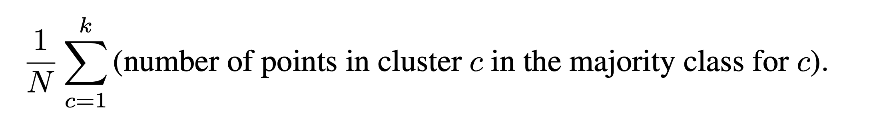
CLASSICAL STATIC EVALUATION
External validation metrics, requiring ground truth values, is mostly based on the following concepts
Accuracy: Fraction of the points assigned to their “correct” cluster.
Recall: Fraction of the points of a cluster that are in fact assigned to it.
Precision: Fraction of the points assigned to a cluster that truly belong to it.
Purity: In a maximally pure clustering, all points in the cluster belong to the same ground-truth class or cluster. Formally, purity is

Slide 27
INTERNAL METRICS: ARE THEY REALLY ONLINE?
Leonardo Enzo Brito Da Silva, Niklas Max Melton and Donald C. Wunsch. 2022. Incremental Cluster Validity Indices for Online Learning of Hard Partitions: Extensions and Comparative Study. IEEE Access, 8 (2020), 22025-22047. https://doi.org/10.1109/ACCESS.2020.2969849.
In 2020, Leonardo Enzo Brito Da Silva et al. introduced a new approach for incremental validity indices. This allows an update to a new value from a previous old value.
However, this approach still has one huge limitation: ALL information of each previous data points still have to be available.
As such, there is a requirement to come up with metrics that are truly incremental (facilitating the fashion of learning one sample at a time).
*Work to be submitted to IEEE Big Data 2022

Slide 28
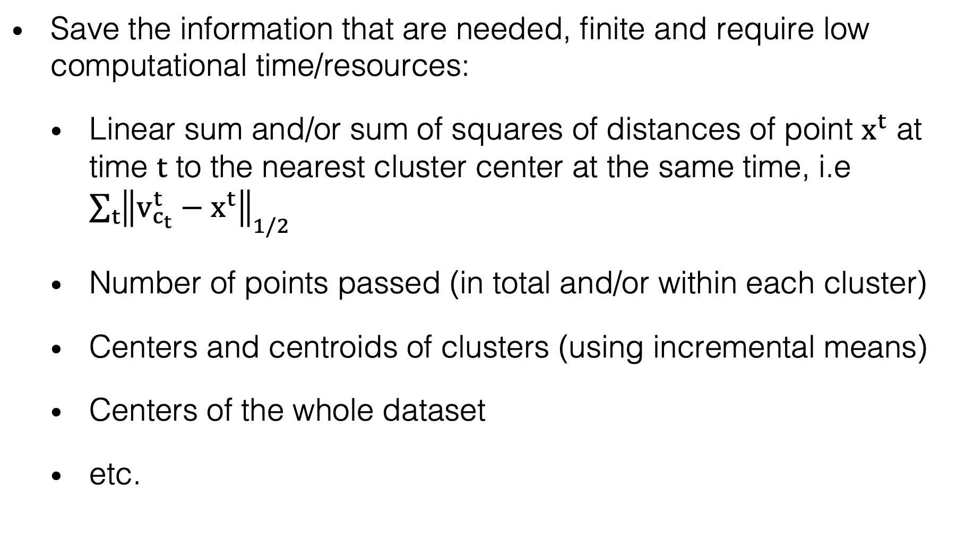
HOW TO DESIGN AN INCREMENTAL INTERNAL METRIC?
Save the information that are needed, finite and require low computational time/resources:
Linear sum and/or sum of squares of distances of point $x^{t}$ at time $t$ to the nearest cluster center at the same time, i.e ${\sum_{t}{\left\|v_{c_{t}}^{t}−x^{t}\right\|}}_{1/2}$
Number of points passed (in total and/or within each cluster)
Centers and centroids of clusters (using incremental means)
Centers of the whole dataset
etc.

Slide 29
INCREMENTAL EVALUATION
In River, static evaluation metrics can be modified to continuously evaluate data streams as follows:
External metrics: All external metrics implemented in River share the same confusion matrix, thus reducing the amount of occupied storage and computational time. This confusion matrix can easily be updated once a new predicted label and its ground truth arrive.
Internal metrics: Since information on previous data points are totally discarded once a new data point arrives, traditional internal metrics cannot be used incrementally. Instead, they are slightly modified by saving the most essential information based on requirement, for example linear sum and sum of squares of data points in the same cluster, distance from data point to assigned and/or second closest cluster centre at the time of update, etc.

Slide 30
INCREMENTAL EVALUATION
With 20 internal metrics and 18 external metrics, River is currently the package with the highest number of metrics offered for data stream continuous or incremental validation.
Internal metrics: Cohesion, SSB, SSW, Separation, Silhouette, Ball-Hall, CH, Hartigan, WB, Xie-Beni, Xu, (Root) Mean Squared Standard Deviation, R-Squared, I Index, Davies-Bouldin, Partition Separation, Dunn’s indices 43 and 53, SD Validation Index, and Bayesian Information Criterion.
External metrics: Completeness, Homogeneity, VBeta, (Adjusted, Expected, Normalized) Mutual Information, Q0 and Q2, Fowlkes-Mallows, Markedness, Informedness, Matthews Correlation Coefficient, (Adjusted) Rand Index, Purity, Prevalence Threshold, and Sorensen-Dice index.

Slide 31
EVALUATION
Every metric (both internal and external) in River contains the following attributes:
cm: Confusion matrix;
update and revert: Allow the metric to be updated with a new observation, or reverted to the previous state;
get: Obtain the exact value of the metric;
bigger-is-better: Indicate whether the metric has the property of the bigger, the better the clustering solution is;
work_with: Indicate whether the metrics work with algorithms of which type (clustering, classification, regression, etc.);
Notes:
Bigger-is-better: useful to evaluate whether newly implemented algorithms work as planned

Slide 32
FURTHER STEPS
Benchmarking
Implementation of more clustering algorithms and/or improvement in performance of current ones (ex. Welford’s algorithm for the information of micro-clusters)
Text-specific clustering algorithms (although this can currently be done using TFIDF + Any clustering model pipeline in River)

Slide 33
PERSONAL THOUGHTS
The world of online clustering is still “chaotic”, with a lot of papers having no official implementation or implementations scattered in different frameworks/languages → Hard to evaluate.
Are we too much dependent on the concept of online and offline phase while doing online clustering?
Online deep clustering (ODC) with the assistance of river-torch? (https://arxiv.org/abs/2006.10645)

Slide 34

Thank you for your attention!

